Slide 1
Shift Register
The Shift Register is another type of sequential logic circuit that can be used for the storage or the transfer of data in the form of binary numbers. This sequential device loads the data present on its inputs and then moves or “shifts” it to its output once every clock cycle, hence the name “shift register”.
Shift register IC’s are generally provided with a clear or reset connection so that they can be “SET” or “RESET” as required.

Slide 2
Shift Register
• Serial-in to Parallel-out (SIPO) - the register is loaded with serial data, one bit at a time, with the stored data being available at the output in parallel form.
• Serial-in to Serial-out (SISO) - the data is shifted serially “IN” and “OUT” of the register, one bit at a time in either a left or right direction under clock control.
• Parallel-in to Serial-out (PISO) - the parallel data is loaded into the register simultaneously and is shifted out of the register serially one bit at a time under clock control.
• Parallel-in to Parallel-out (PIPO) - the parallel data is loaded simultaneously into the register, and transferred together to their respective outputs by the same clock pulse.

Slide 3
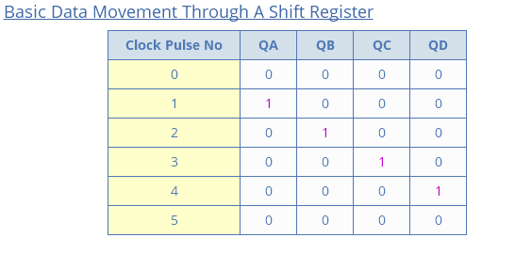

Slide 4
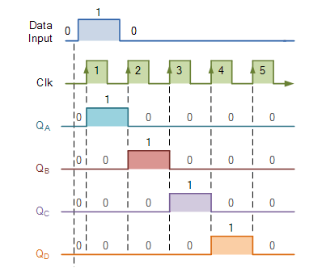

Slide 5
Serial In Serial Out

Slide 6
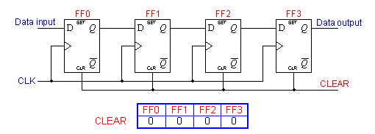
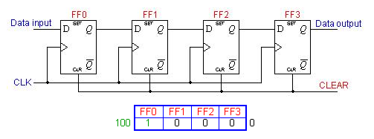

Slide 7
Serial In Parallel Out

Slide 8
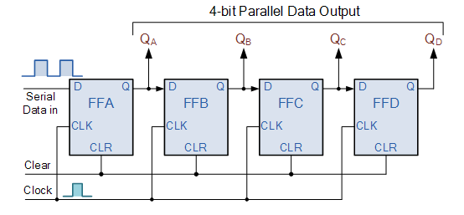

Slide 9
Parallel in Parallel out

Slide 10
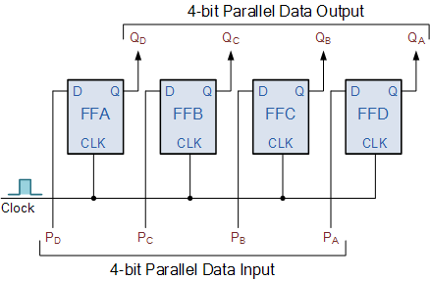

Slide 11
Parallel in serial out
A, B, C, and D are the four parallel data input lines.
SHIFT / LOAD (SH / LD) is a control input.
When SHIFT / LOAD is HIGH, AND gates G1, G3, and G5 are enabled, allowing the data bits to shift right from one stage to the next.
When SHIFT / LOAD is LOW, AND gates G2, G4, and G6 are enabled, allowing the data bits at the parallel inputs.

Slide 12
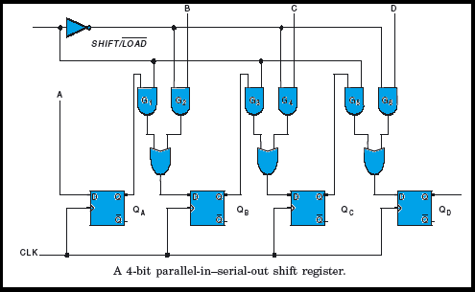

Slide 13
Bidirectional Shift Register

Slide 14
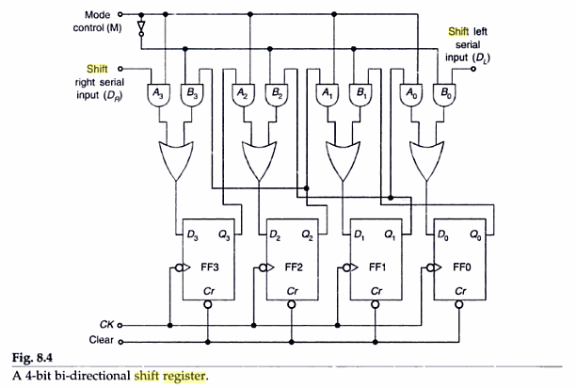

Slide 15
Bidirectional Shift Register
When Mode Control M=1 , all A AND gates are enabled and data at D(R) is shifted to right when clock pulses are applied.
When Mode Control M=0 , all B AND gates are enabled and data at D(L) is shifted to left when clock pulses are applied.
M should change only when clock is 0

